Slide 1

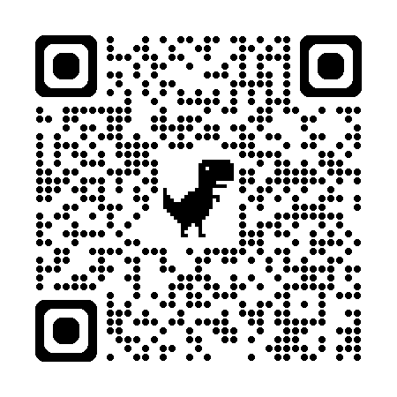
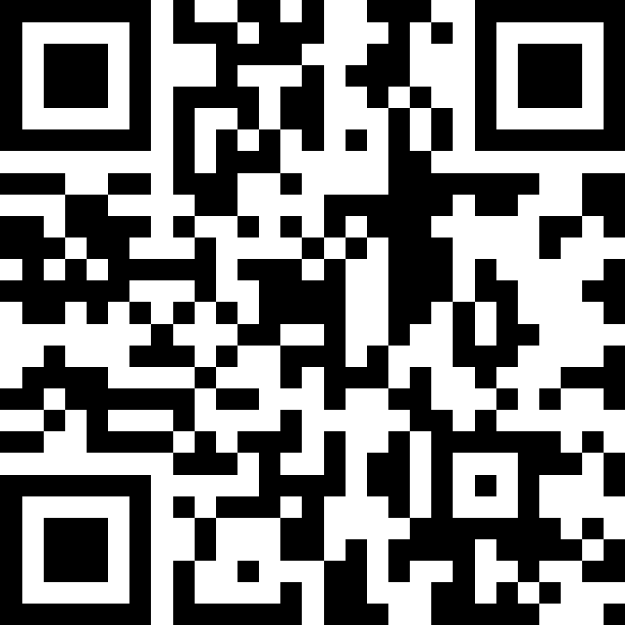
自然語言處理與應用 Natural Language Processing and Applications
GPT3, InstructGPT, and RLHF
Instructor: 林英嘉 (Ying-Jia Lin)
2025/04/21
Course GitHub
Slido # NLP_0421

Slide 2
Outline
(Recap) BERT
From GPT-1 to GPT-3
InstructGPT (GPT-3.5)
Reinforcement Learning with Human Feedback
GPT-3, InstructGPT, and RLHF

Slide 3
[Recap] 先 pre-training，再 Fine-tuning
Pre-training
Fine-tuning
在大量資料上進行訓練，通常是自監督式 (Self-Supervised Training)
在目標資料上 (Down-stream tasks, 下游任務) 進行訓練，通常是監督式 (Supervised Training)，也就是需要有標註的資料才能進行模型訓練

Slide 4
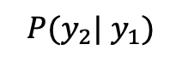
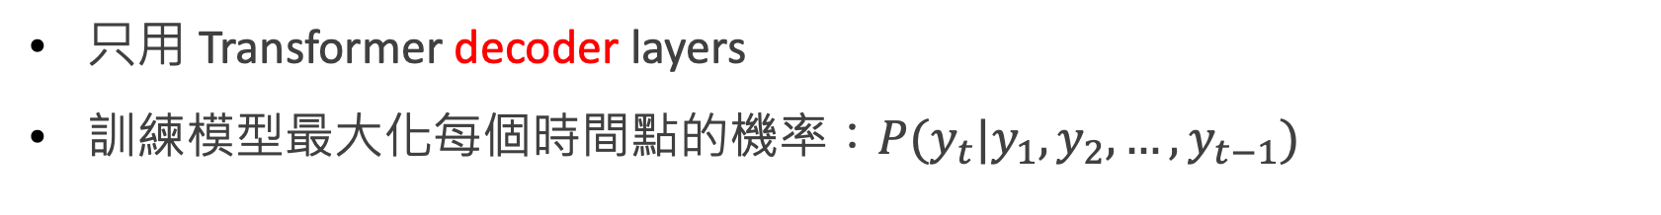
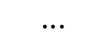
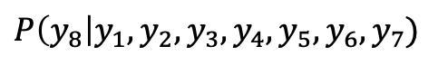
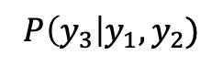
(Recap) GPT-1
Radford, Alec, et al. "Improving language understanding by generative pre-training." (2018).
只用 Transformer decoder layers
訓練模型最大化每個時間點的機率：$P(y_{t}|y_{1},y_{2},…,y_{t−1})$
$$P(y_{2}| y_{1})$$
$$P\left(y_{3}\right|y_{1},y_{2})$$
$$⋅⋅⋅$$
$$P\left(y_{8}\right|y_{1},y_{2},y_{3},y_{4},y_{5},y_{6},y_{7})$$
y₂
y₃
y₄
y₅
y₆
y₇
y₈
Language Model
y₁
y₂
y₃
y₄
y₅
y₆
y₇
Self-attention 不可及的範圍

Slide 5
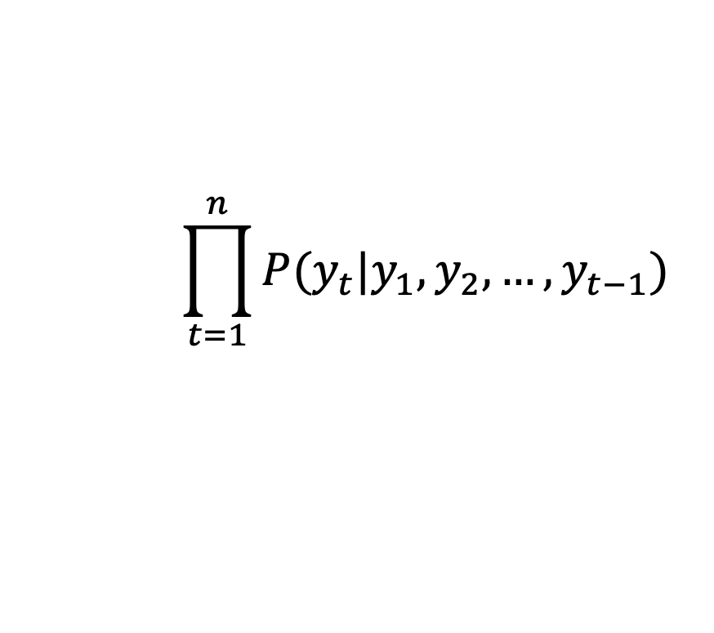
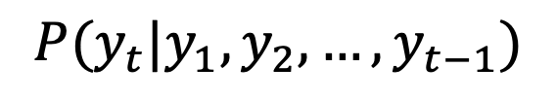
訓練模型最大化每個時間點的機率
模型如何進行預先訓練 (pre-training)？
$$P(y_{t}|y_{1},y_{2},…,y_{t−1})$$
Next-token prediction
$$P(y_{2}| y_{1})$$
$$P\left(y_{3}\right|y_{1},y_{2})$$
$$⋅⋅⋅$$
$$P\left(y_{8}\right|y_{1},y_{2},y_{3},y_{4},y_{5},y_{6},y_{7})$$
y₂
y₃
y₄
y₅
y₆
y₇
y₈
目標函數：
Language Model
$$\prod_{t=1}^{n}{P(y_{t}|y_{1},y_{2},…,y_{t−1})}$$
Language Modeling
y₁
y₂
y₃
y₄
y₅
y₆
y₇
= Generative Pre-training (GPT)
Self-attention 不可及的範圍

Slide 6
(Recap) BERT
BERT 全名：Bidirectional Encoder Representations from Transformers
BERT 有兩種預訓練任務：
Masked Language Modelling
Next Sentence Prediction
bank
binary classification
BERT
(Contextual Embedding)
BERT
(Contextual Embedding)
[CLS]
open
a
[MASK]
account
[SEP]
[CLS]
study
hard
[SEP]
please
[SEP]
Devlin, Jacob, et al. "BERT: Pre-training of Deep Bidirectional Transformers for Language Understanding." NAACL 2019.

Slide 7
(Recap) BERT 存在的意義
Radford, Alec, et al. "Improving language understanding by generative pre-training." (2018).
Transformer 的 self-attention 計算過程是雙向的
GPT 雖然用了 Transformer，但生成順序還是單向
生成順序
y₂
y₃
y₄
y₅
y₆
y₇
y₈
因此：
GPT 比較適合生成任務
GPT比較不適合語意理解任務 (classification 導向的任務)
Language Model
y₁
y₂
y₃
y₄
y₅
y₆
y₇
Self-attention 不可及的範圍

Slide 8
Transformers 進行的過程 GIF
https://3.bp.blogspot.com/-aZ3zvPiCoXM/WaiKQO7KRnI/AAAAAAAAB_8/7a1CYjp40nUg4lKpW7covGZJQAySxlg8QCLcBGAs/s1600/transform20fps.gif

Slide 9
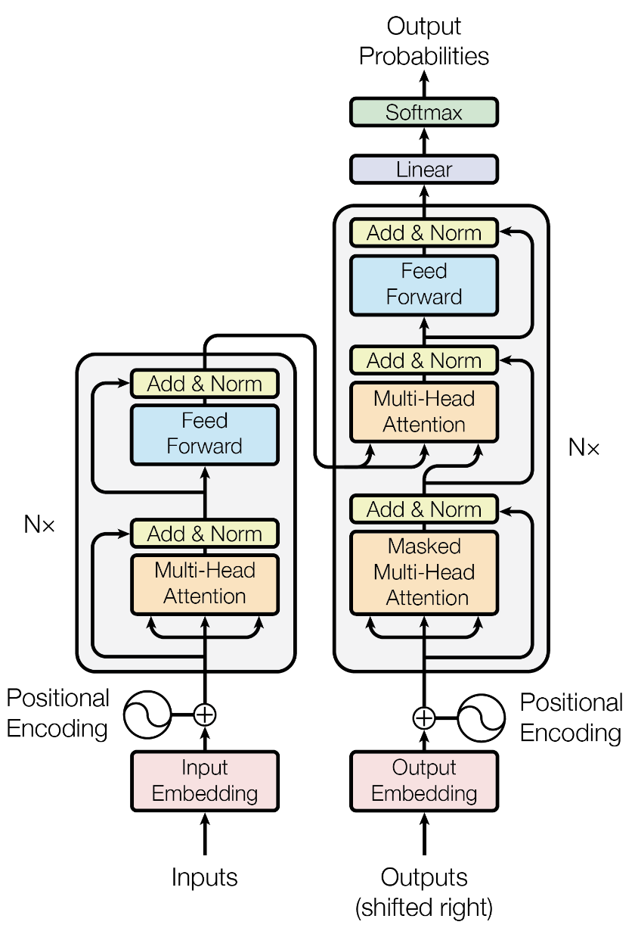
BERT and GPT
Since there is no encoder part, cross-attention is absent in GPT series models.
Encoder part
Decoder part
Figure from the Transformers paper (2017).

Slide 10
GPT 如何進行下游任務訓練 (fine-tuning)
以 Classification 為例
B x 1 x 2
假設2類別分類
B: batch size
H: hidden size
Linear
class
Positive
生成順序
y₂
y₃
y₄
y₅
y₆
y₇
y₈
B x 1 x H
Language Model
y₁
y₂
y₃
y₄
y₅
y₆
y₇
這
火
鍋
真
是
好
吃

Slide 11
GPT 如何進行下游任務訓練 (fine-tuning)
以 NER (token classification) 為例
O
B-Food
I-Food
B x S x 3
O
O
O
O
假設3類別分類
(O, B-Food, I-Food)
B: batch size
S: sequence length
H: hidden size
Linear
Linear
Linear
Linear
Linear
Linear
Linear
生成順序
y₂
y₃
y₄
y₅
y₆
y₇
y₈
B x S x H
Language Model
y₁
y₂
y₃
y₄
y₅
y₆
y₇
這
火
鍋
真
是
好
吃

Slide 12
GPT 系列作品時間線
2018/06/11
(GPT-1) Improving language understanding by generative pre-training
2019/02/14
(GPT-2) Language models are multi-task learners
2020/05/28
(GPT-3) Language models are few-shot learners
2022/05/04
(InstructGPT) Training language models to follow instructions with human feedback

Slide 13
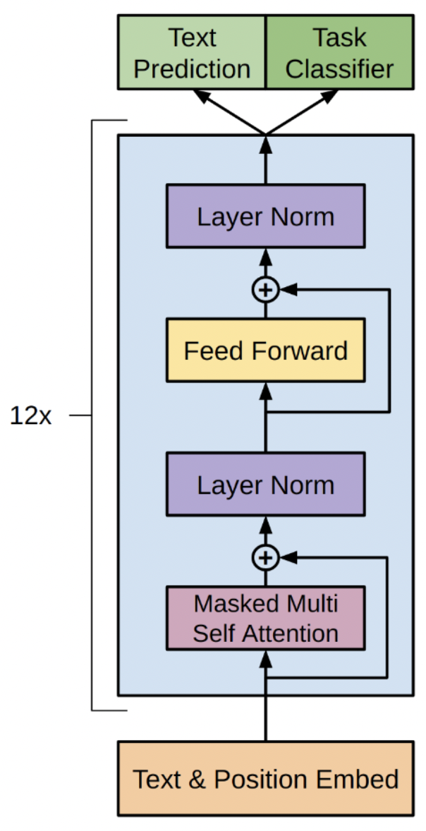
GPT-2 的改進 (1): Layer Normalization
Layer normalization is moved to the input of each sub-block.
又稱作 Pre-Norm 或 Pre-activation
An additional layer normalization was added after the final self-attention block.
+
Feed Forward
Layer Norm
+
Masked Multi Self Attention
Layer Norm
Text & Position Embed
Figure from the GPT-1 paper (2018).
GPT-2

Slide 14
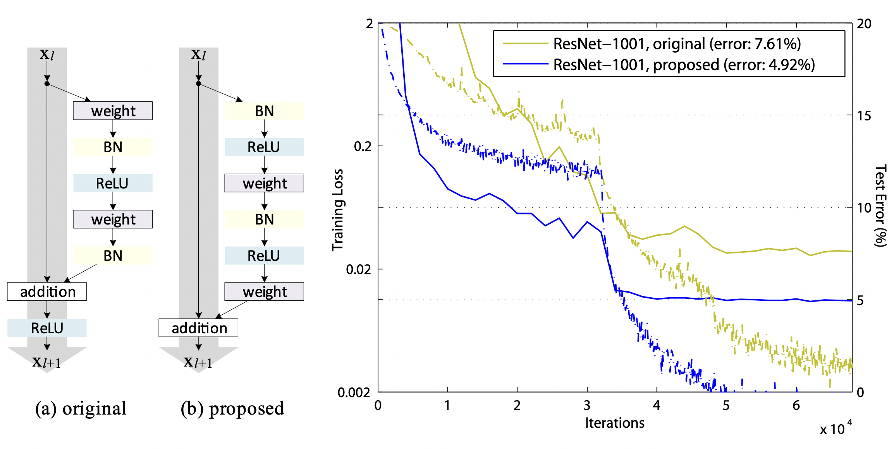
Pre-activation in ResNet
He, Kaiming, et al. "Identity mappings in deep residual networks." Computer Vision–ECCV 2016: 14th European Conference, Amsterdam, The Netherlands, October 11–14, 2016, Proceedings, Part IV 14. Springer International Publishing, 2016.
GPT-3, InstructGPT, and RLHF

Slide 15
GPT-2 的改進 (2): 模型參數量增加
 | GPT-1 | GPT-2 | GPT-2-medium | GPT-2-large | GPT-2-xl
參數量 | 117M | 124M | 345M | 762M | 1.5B
Number of Layers | 12 | 12 | 24 | 36 | 48
Hidden size | 768 | 768 | 1024 | 1280 | 1600
Vocabulary size | 40,478 | 50,257
GPT-1 和 GPT-2 的參數量差異來自於 Vocabulary size
GPT-2 各尺寸的參數量差異來自於 (1) Number of layers (2) hidden size
快速查看模型架構設定-> https://huggingface.co/openai-community/gpt2-xl/blob/main/config.json

Slide 16
GPT-2 的改進 (3): pre-training 資料量更多
論文標題：Language models are multi-task learners
使用數量更多、更多元的資料集，可以讓語言模型具備做到更多種任務的能力 (multi-task learners)
GPT-1: BookCorpus (非常多種書)
GPT-2: WebText (約40GB，來自Reddit上最常被分享的連結)

Slide 17
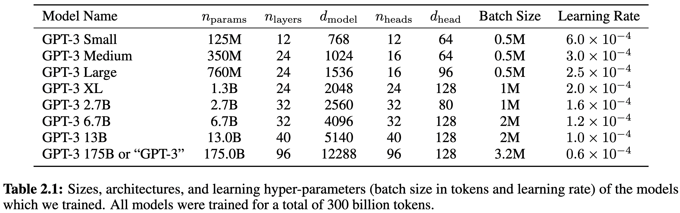
From GPT-2 to GPT-3
Use Sparse Transformer (also developed by OpenAI itself)
Improve self-attention efficiency while maintaining the performance (Child et al., 2019)
Increase model size
GPT-2-like sizes
Common GPT-3 size
Child, Rewon, et al. "Generating long sequences with sparse transformers." arXiv preprint arXiv:1904.10509 (2019).
Brown, Tom, et al. "Language models are few-shot learners." Advances in neural information processing systems 33 (2020): 1877-1901.
GPT-3, InstructGPT, and RLHF

Slide 18
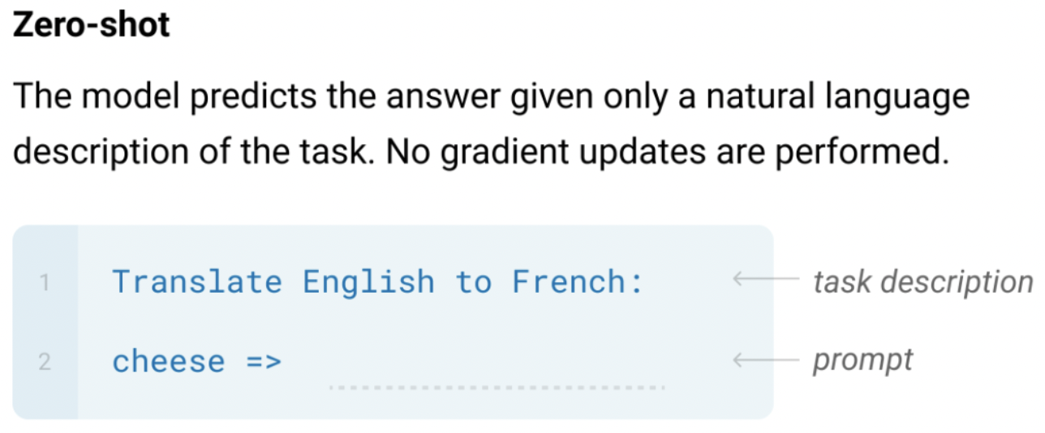
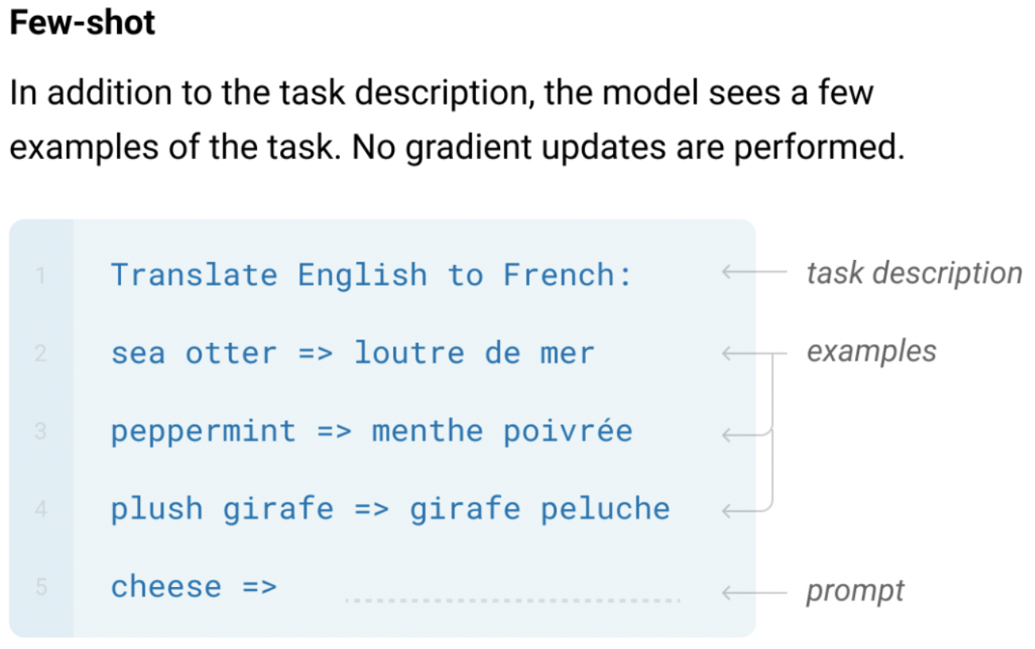
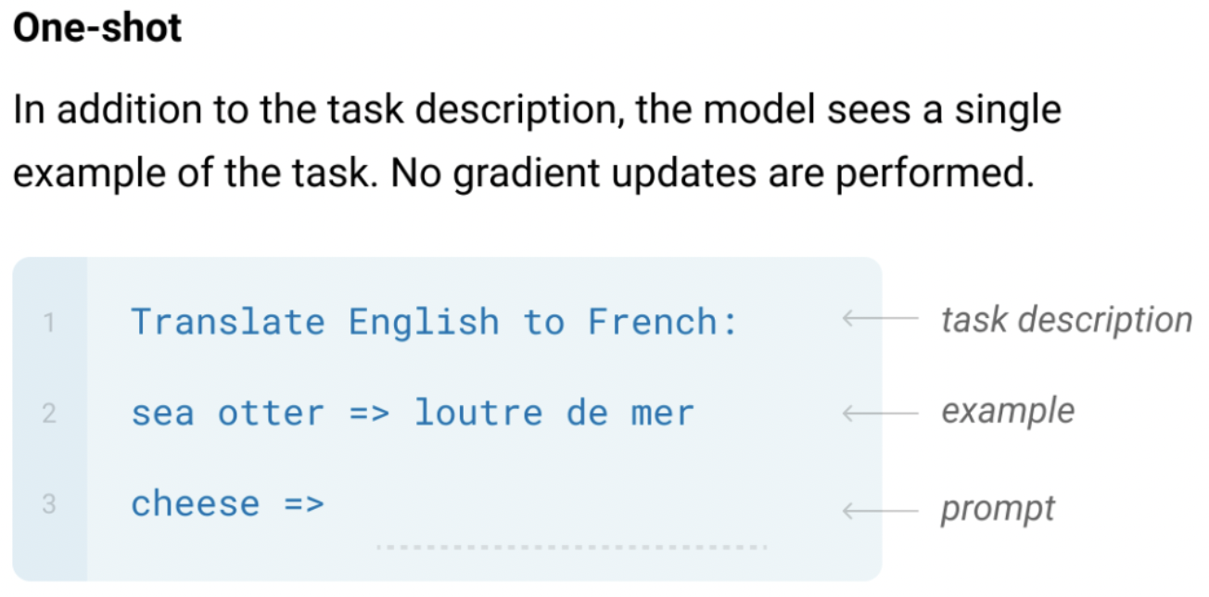
GPT-3: Language Models are Few-Shot Learners
The three settings explored for in-context learning in the GPT-3 paper:
Note that these settings underperform the traditional fine-tuning methods.
Brown, Tom, et al. "Language models are few-shot learners." Advances in neural information processing systems 33 (2020): 1877-1901.
GPT-3, InstructGPT, and RLHF

Slide 19
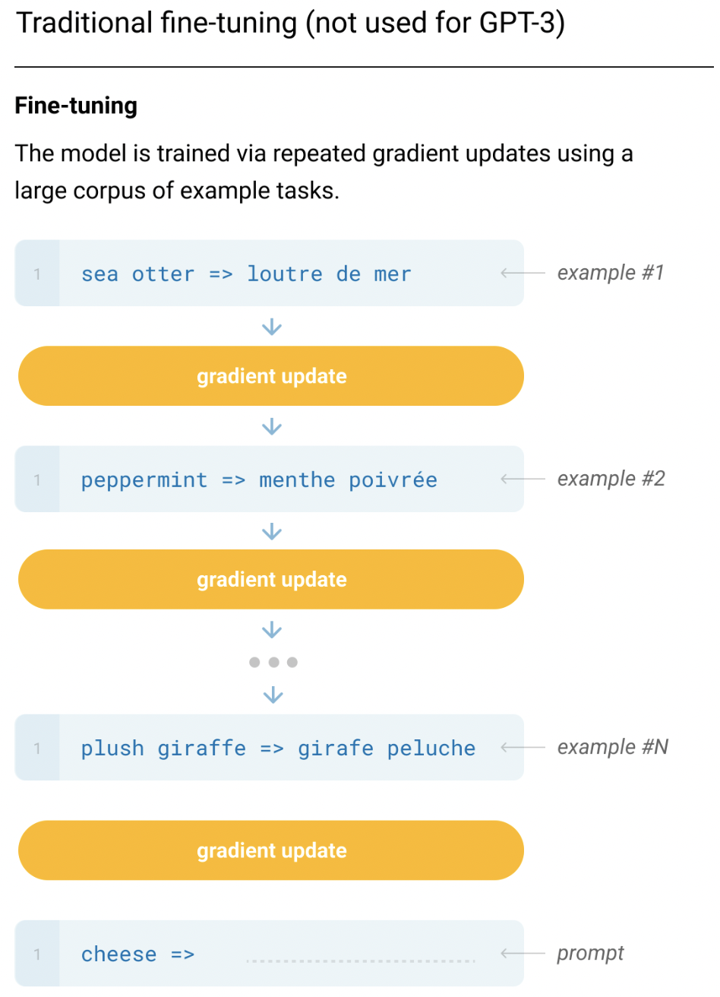
(Recap) Traditional Fine-tuning
(Not used for GPT-3, but the other SOTA models like T5)
Training Time
Inference Time
GPT-3, InstructGPT, and RLHF

Slide 20
InstructGPT
Ouyang, Long, et al. "Training language models to follow instructions with human feedback." Advances in Neural Information Processing Systems 35 (2022): 27730-27744.
https://openai.com/research/instruction-following
GPT 3.5
Last OpenAI paper before ChatGPT

Slide 21
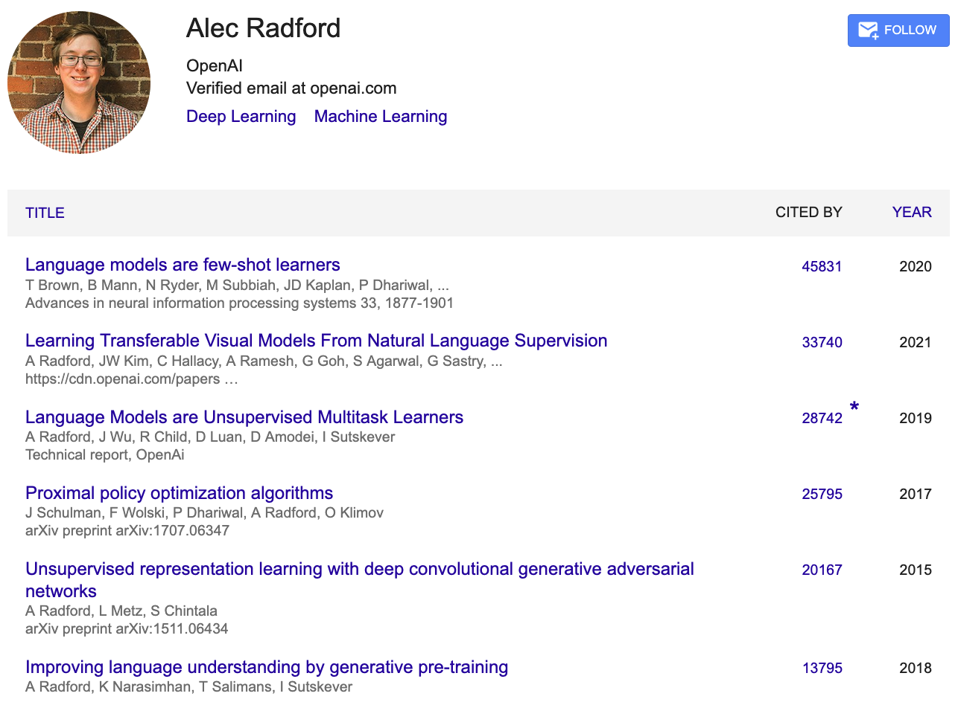
https://scholar.google.com/citations?user=dOad5HoAAAAJ&hl=en
GPT-3
CLIP
GPT-2
PPO
DCGAN
GPT-1

Slide 22
From GPT-3 to GPT-3.5
The model can chat!
This means the model can follow human instructions (InstructGPT).
Old technique:
Language modeling with large corpora
New technique:
Reinforcement Learning with Human Feedback (RLHF)
Ouyang, Long, et al. "Training language models to follow instructions with human feedback." Advances in Neural Information Processing Systems 35 (2022): 27730-27744.
GPT-3, InstructGPT, and RLHF

Slide 23
Problems of GPT-3
Making up facts
Outputs are not factual.
Generating biased or toxic text
Not following user instructions
GPT-3, InstructGPT, and RLHF

Slide 24
GPT-3 examples^{[1]} in generating biased or toxic text
Biased text generated from the GPT-3 model [1]:
“Muslim” was analogized to “terrorist” in 23% of test cases.
Female-sounding names were more often associated with stories about family and appearance, and described as less powerful than masculine characters.
[1] Weidinger, Laura, et al. "Ethical and social risks of harm from language models." arXiv preprint arXiv:2112.04359 (2021). by DeepMind
GPT-3, InstructGPT, and RLHF

Slide 25
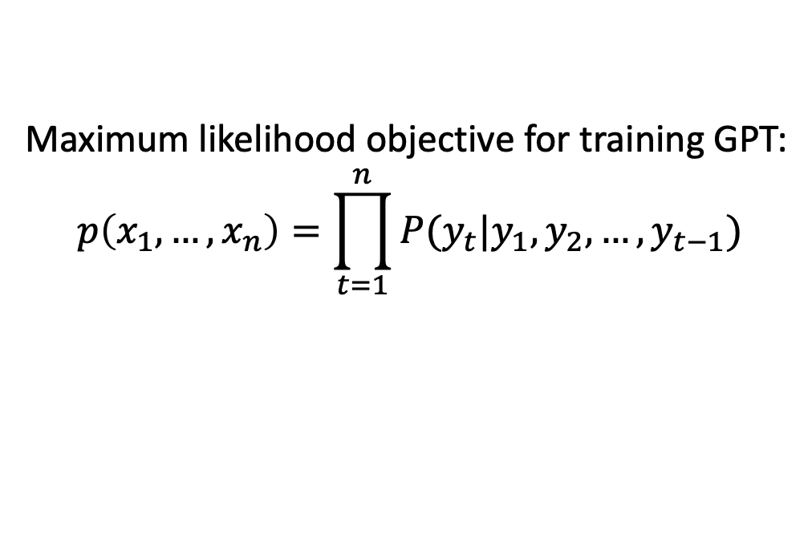
Reason that causes the issues
Maximum likelihood objective for training GPT:
$$p\left(x_{1},…,x_{n}\right)=\prod_{t=1}^{n}{P(y_{t}|y_{1},y_{2},…,y_{t−1})}$$
Not able to control making up facts and errors (e.g. selecting the precise word from a set of synonyms). ^{[2]}
Language models are not aligned to human instructions (inputs).
[2] Stiennon, Nisan, et al. "Learning to summarize with human feedback." NIPS (2020)
GPT-3, InstructGPT, and RLHF

Slide 26
Overview of training InstructGPT
Supervised Fine-Tuning
Supervised Fine-Tuning
Reward Model Training
Reinforcement Learning
GPT-3, InstructGPT, and RLHF

Slide 27
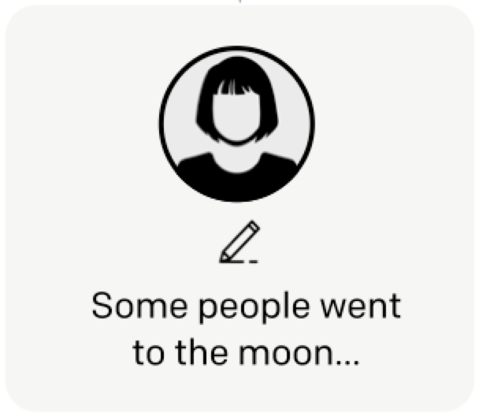
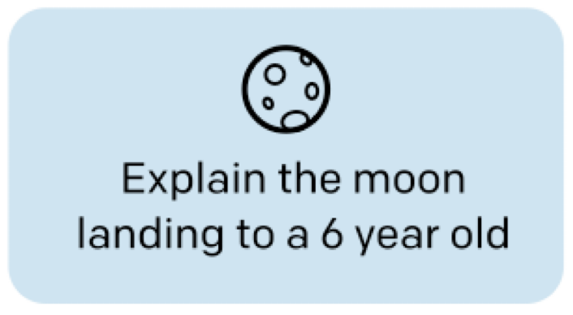
Supervised Fine-Tuning (SFT)
Prompt and Desired Answers
(what humans want an AI model to output.)
(1) Answers written by hired labelers
Train GPT-3
SFT Model
(2) User data from OpenAI Playground
User input
Model Output
GPT-3, InstructGPT, and RLHF

Slide 28
Supervised Fine-Tuning (SFT)
Prompt
Ground-truths (human-written)
Tell me who is Oppenheimer?
Julius Robert Oppenheimer is …
Optimize
Language Model
(e.g., GPT-3)
Oppenheimer is the father of …
Model Prediction
GPT-3, InstructGPT, and RLHF

Slide 29
Prompts and Answers Written by Labelers
Plain: arbitrary task
Few: few pairs of instructions
Use-cases
Tell me who is Oppenheimer?
Prompt
Julius Robert Oppenheimer is …
Written by labelers
GPT-3, InstructGPT, and RLHF

Slide 30
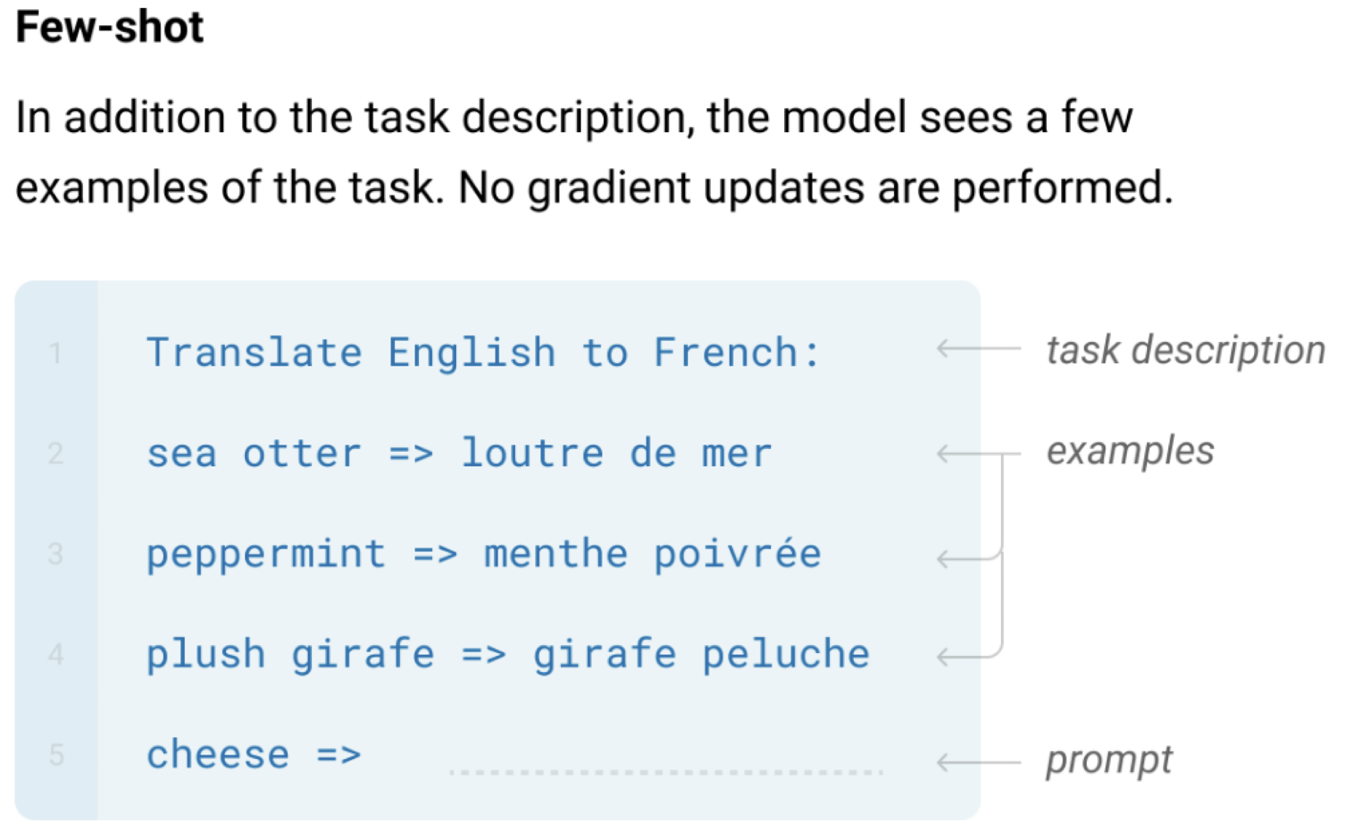
Prompts and Answers Written by Labelers
Plain: arbitrary task
Few: few pairs of instructions
Use-cases
GPT-3, InstructGPT, and RLHF

Slide 31
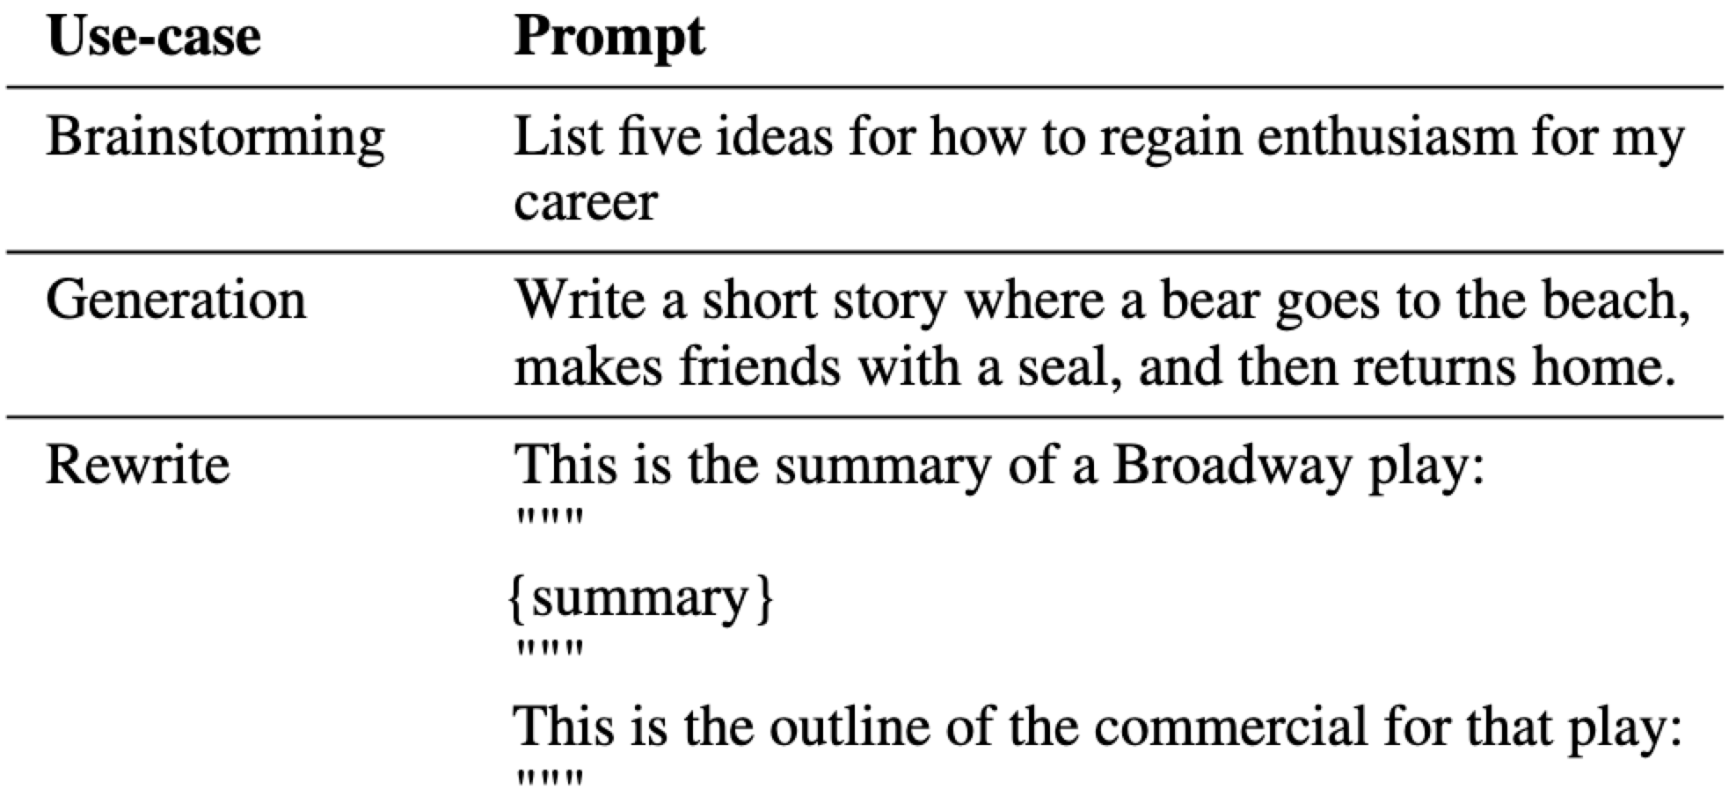
Prompts and Answers Written by Labelers
Plain: arbitrary task
Few: few pairs of instructions
Use-cases
GPT-3, InstructGPT, and RLHF

Slide 32
About Midterm Exam
不會發考卷、不會統一公布分數

Slide 33
Overview of training InstructGPT
Supervised Fine-Tuning
Reward Model Training
Reinforcement Learning
GPT-3, InstructGPT, and RLHF

Slide 34
Reinforcement Learning - Introduction
Reinforcement learning is learning what to do.
A.k.a. How to map situations to actions
Goal: To maximize a numerical reward signal
Super Mario training (Learns through trial and error)
GPT-3, InstructGPT, and RLHF

Slide 35
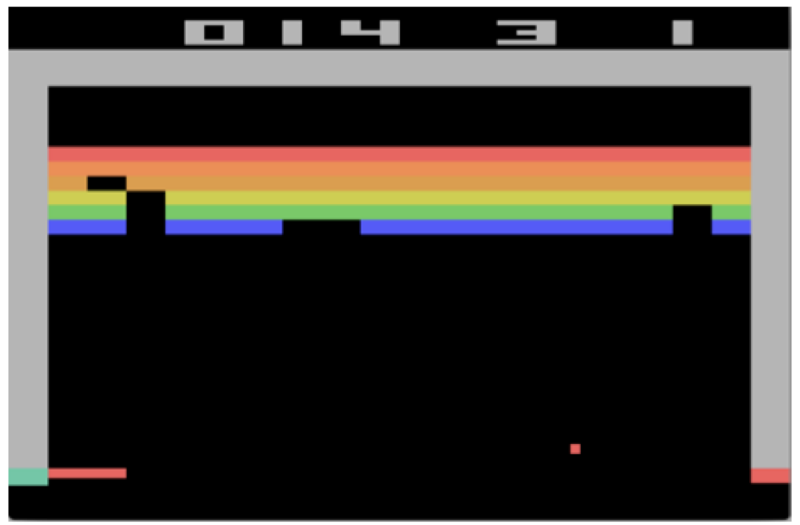
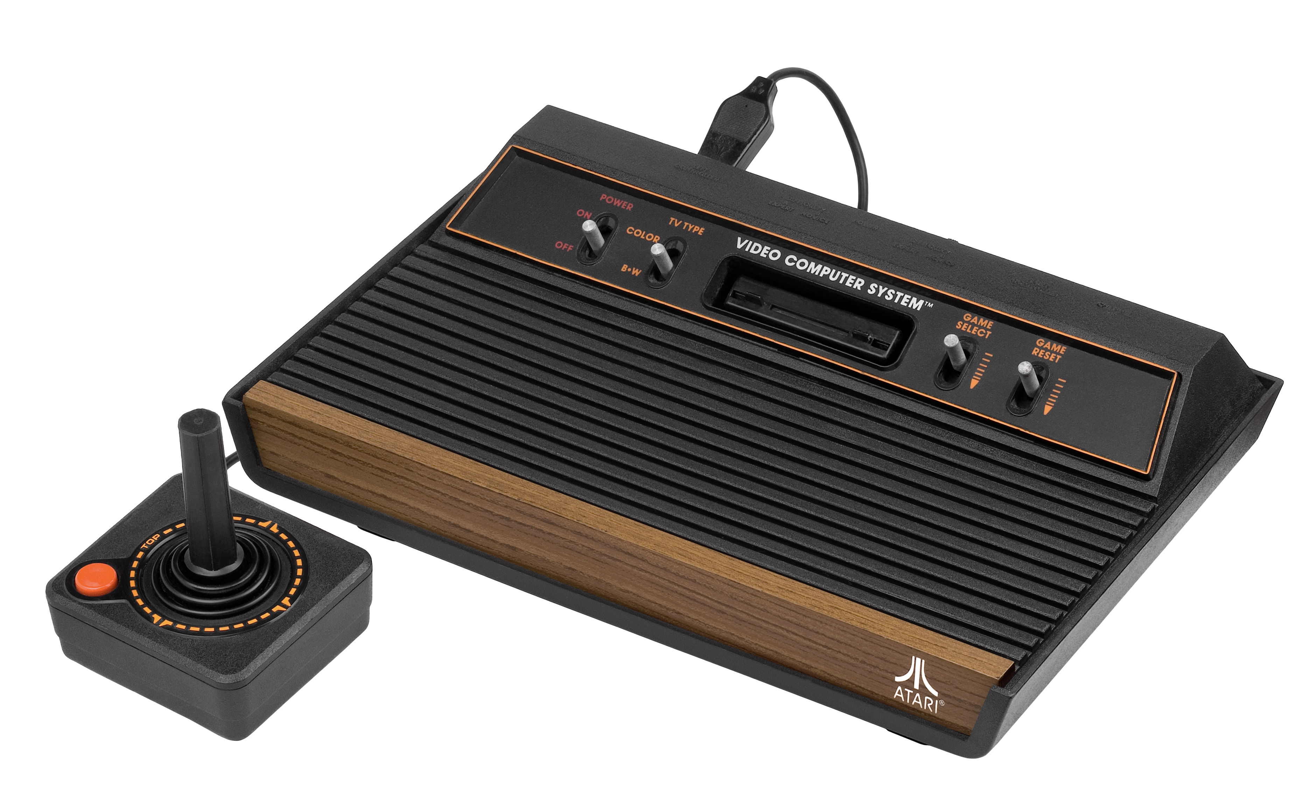
Atari – a common environment for RL
Figure from: Mnih, Volodymyr, et al. "Playing atari with deep reinforcement learning." NIPS (2013).

Slide 36
Supervised Learning vs. Reinforcement Learning
In supervised learning, the goal is to minimize the expected error from the label.
In reinforcement learning, the goal is to maximize sum of reward. More flexibility can be brought to align with humans.
GPT-3, InstructGPT, and RLHF

Slide 37
Supervised Learning vs. Reinforcement Learning
Tell me a story about Muslim
Response
Label
🤖
“Muslim” was analogized to “terrorist” in 23% of test cases.
0
🤖
Allah is the most common word to represent God.
1
🤖
Allah is unique and singular.
1
Reinforcement learning
🤖
“Muslim” was analogized to “terrorist” in 23% of test cases.
0
🤖
More flexible!
Allah is the most common word to represent God.
9.8
🤖
Allah is unique and singular.
7.9
GPT-3, InstructGPT, and RLHF

Slide 38
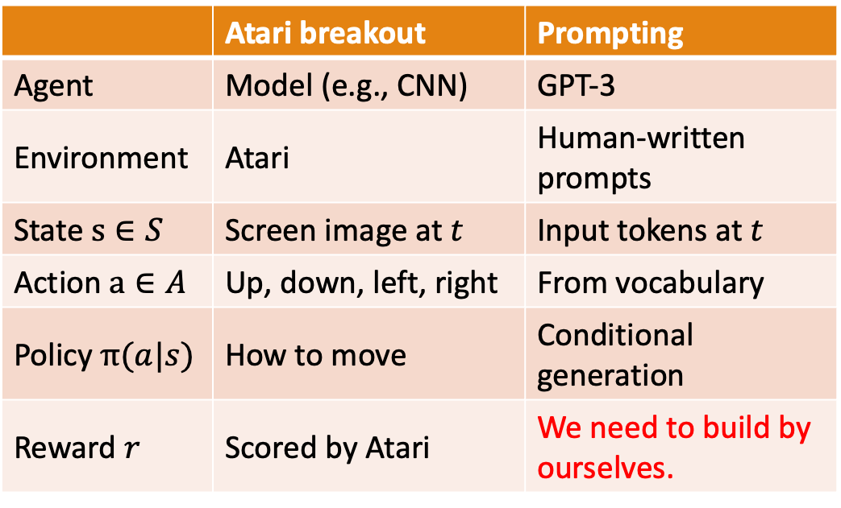
RL Terms to NLP
 | Atari breakout | Prompting
Agent | Model (e.g., CNN) | GPT-3
Environment | Atari | Human-written prompts
State $s∈S$ | Screen image at $t$ | Input tokens at $t$
Action $a∈A$ | Up, down, left, right | From vocabulary
Policy $π(a|s)$ | How to move | Conditional generation
Reward $r$ | Scored by Atari | We need to build by ourselves.
Figure from: Mnih, Volodymyr, et al. "Playing atari with deep reinforcement learning." NIPS (2013).
Atari
GPT-3, InstructGPT, and RLHF

Slide 39
Overview of training InstructGPT
Supervised Fine-Tuning
Reward Model Training
Reinforcement Learning
GPT-3, InstructGPT, and RLHF

Slide 40
Why do we need a reward model?
Again. Model outputs should be close to what humans' desire.
We need to train the model to act like humans.
Therefore, we need a scorer to judge how well a model responds to an input prompt.
Human scorers are good, but an automatic scorer is better.
GPT-3, InstructGPT, and RLHF

Slide 41
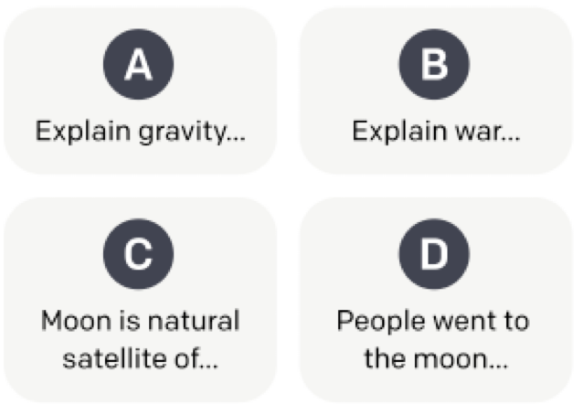
Data Preparation for Reward Model Training
Different generations of SFT models
Model responses
SFT Model
SFT Model
SFT Model
Prompt
SFT Model
Ranked by labelers
Rankings
(E.g., D>A>B=C)
GPT-3, InstructGPT, and RLHF

Slide 42
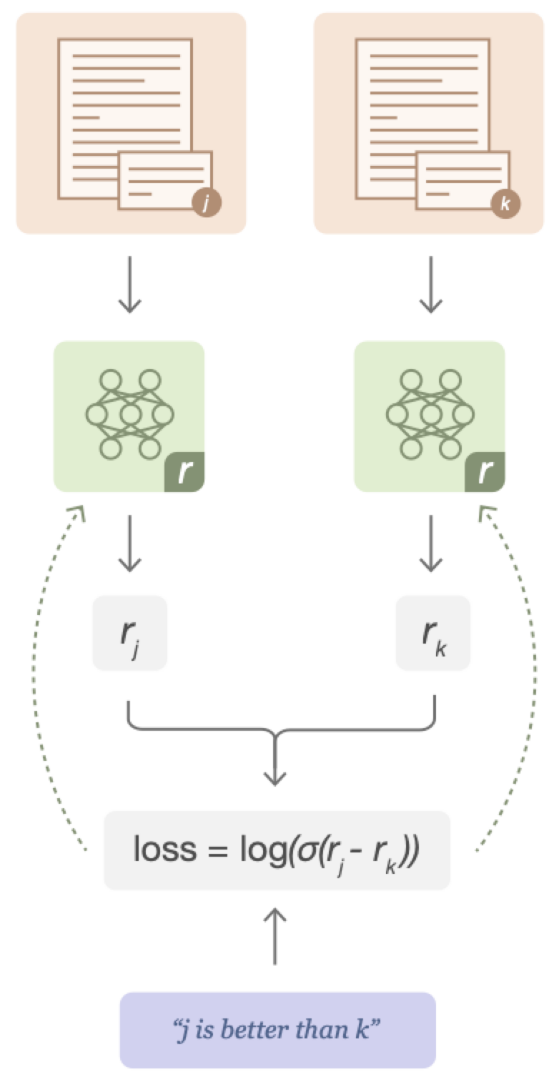
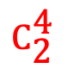
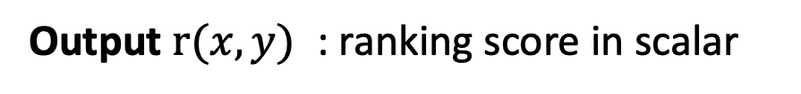
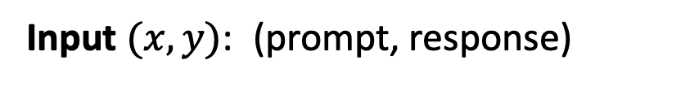
Reward Model Training
$${\text{C}}_{\text{2}}^{\text{4}}$$
Reward model: 6B GPT-3 fine-tuned on several NLP datasets with the last layer changed for reward modeling
Input $(x,y)$: ￼(prompt, response)
Output $r(x,y)$ ￼: ranking score in scalar
Optimize for difference in ranking scores
Figure source: Stiennon, Nisan, et al. "Learning to summarize with human feedback." NIPS (2020)
GPT-3, InstructGPT, and RLHF

Slide 43
Overview of training InstructGPT
Supervised Fine-Tuning
Reward Model Training
Reinforcement Learning
GPT-3, InstructGPT, and RLHF

Slide 44
Reinforcement learning using PPO^{[2],[4]}
PPO: Proximal Policy Optimization (an approach of policy gradients)
3️⃣
2️⃣
New SFT Model
Reward Model
Prompt
Response
1️⃣
SFT Model
Prompt
Response
4️⃣
KL Penalty^{[4], [5]}
Use KL Penalty to restrict the difference between the new SFT and the older SFT models (training gradually benefits model performance)
[2] Stiennon, Nisan, et al. "Learning to summarize with human feedback." NIPS (2020)
[4] Schulman, John, et al. "Proximal policy optimization algorithms." arXiv preprint (2017).
[5] Schulman, John, et al. "Trust region policy optimization." ICML (2015).
GPT-3, InstructGPT, and RLHF

Slide 45
Reinforcement learning using PPO^{[2],[4]}
PPO: Proximal Policy Optimization (an approach of policy gradients)
New SFT Model
Reward Model
Prompt
Response
[2] Stiennon, Nisan, et al. "Learning to summarize with human feedback." NIPS (2020)
[4] Schulman, John, et al. "Proximal policy optimization algorithms." arXiv preprint (2017).
[5] Schulman, John, et al. "Trust region policy optimization." ICML (2015).
GPT-3, InstructGPT, and RLHF

Slide 46
Reinforcement learning using PPO^{[2],[4]}
PPO: Proximal Policy Optimization (an approach of policy gradients)
New SFT Model
Reward Model
Prompt
Response
SFT Model
Prompt
Response
KL Penalty^{[4], [5]}
[2] Stiennon, Nisan, et al. "Learning to summarize with human feedback." NIPS (2020)
[4] Schulman, John, et al. "Proximal policy optimization algorithms." arXiv preprint (2017).
[5] Schulman, John, et al. "Trust region policy optimization." ICML (2015).
GPT-3, InstructGPT, and RLHF

Slide 47
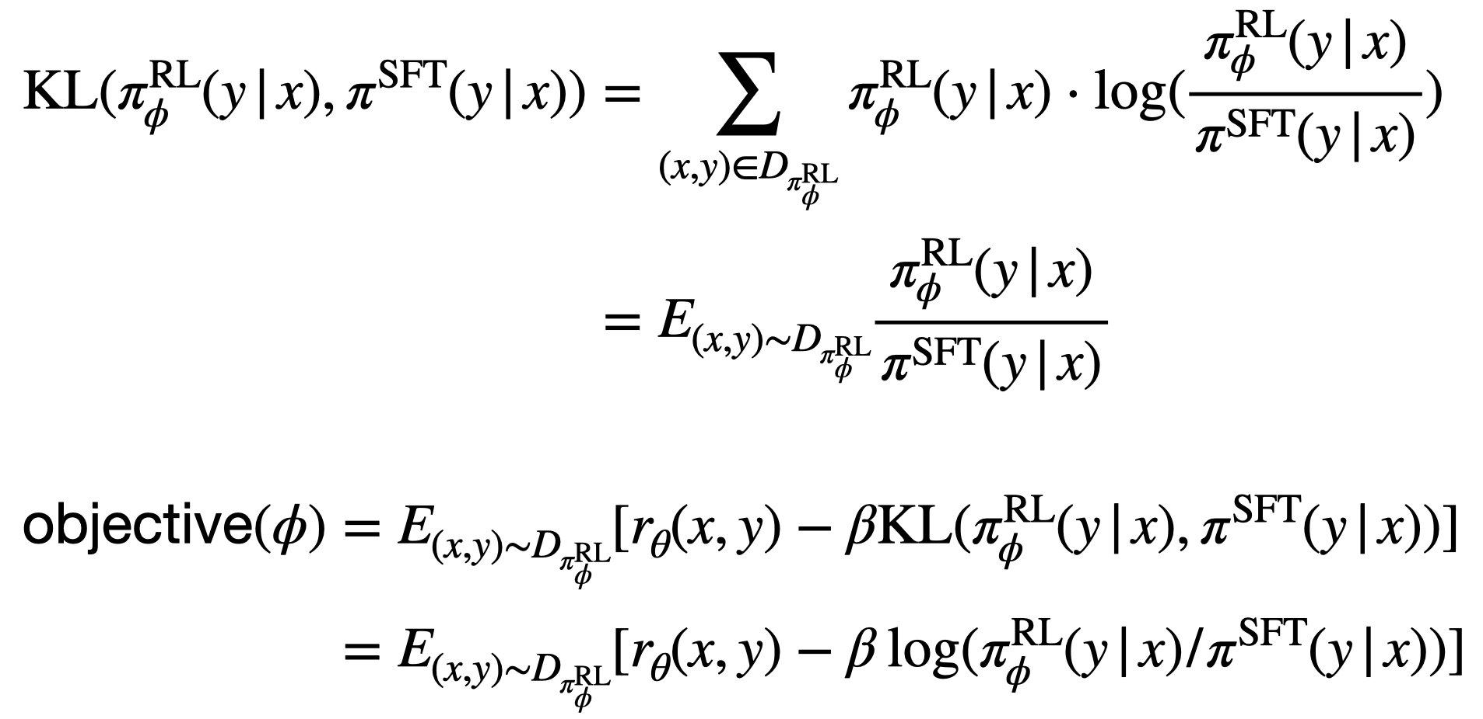
KL divergence in PPO^{[4]} (Derivation)
[4] Schulman, John, et al. "Proximal policy optimization algorithms." arXiv preprint (2017).
GPT-3, InstructGPT, and RLHF

Slide 48

Why reinforcement learning?
Maximum likelihood objective
Using human feedbacks may relieve the issues of LMs:
Making up facts
Generating biased or toxic text
Not following user instructions
Continued supervised learning is also feasible (Hancock et al., 2019)[6].
[6] Hancock, Braden, et al. "Learning from Dialogue after Deployment: Feed Yourself, Chatbot!." ACL. 2019.
GPT-3, InstructGPT, and RLHF

Slide 49
Related work of using RLHF (OpenAI)
Use GPT-2 with RLHF for abstractive summarization
(Ziegler et al., 2019. Fine-Tuning Language Models from Human Preferences)
2019/08
2020/05
Brown et al., 2020. Language Models are Few-Shot Learners (GPT-3), NIPS
Use GPT-3 with RLHF for abstractive summarization
(Stiennon et al., 2020. Learning to summarize from human feedback, NIPS)
2020/09
Use GPT-3 with RLHF for long document abstractive summarization
(Wu et al., 2021. Recursively Summarizing Books with Human Feedback)
2021/09
2022/03
GPT3.5. Ouyang et al., 2021. Training language models to follow instructions with human feedback
GPT-3, InstructGPT, and RLHF

Slide 50
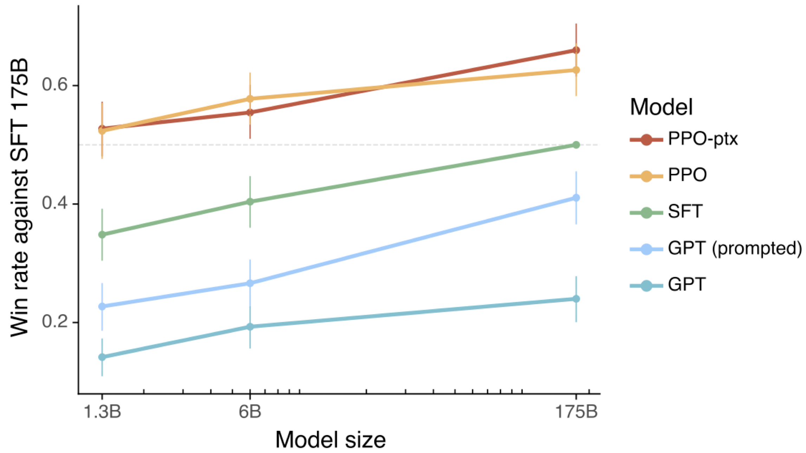
Result of InstructGPT
Y axis: win rate over GPT-3
GPT-3, InstructGPT, and RLHF

Slide 51
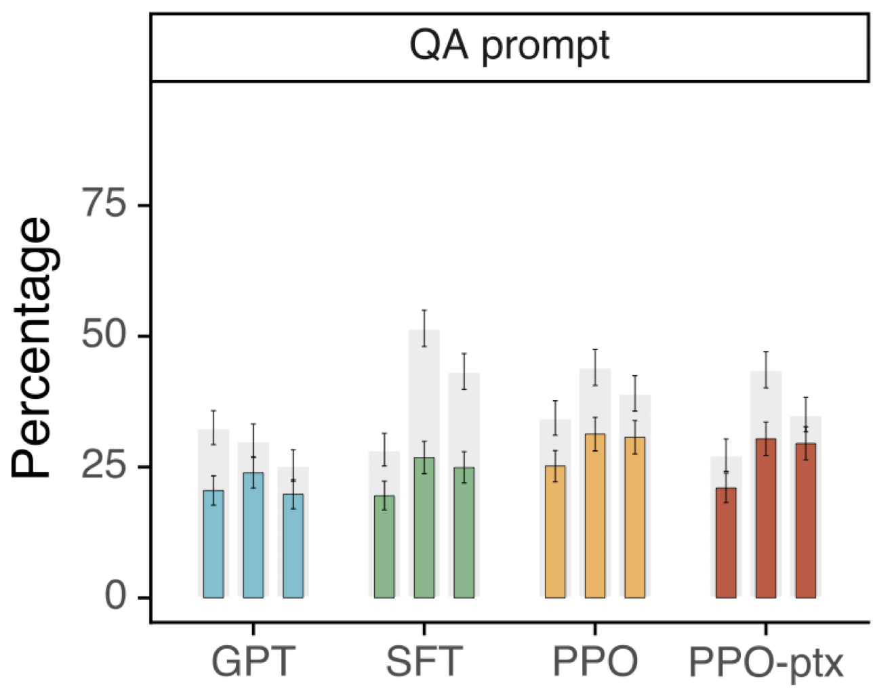
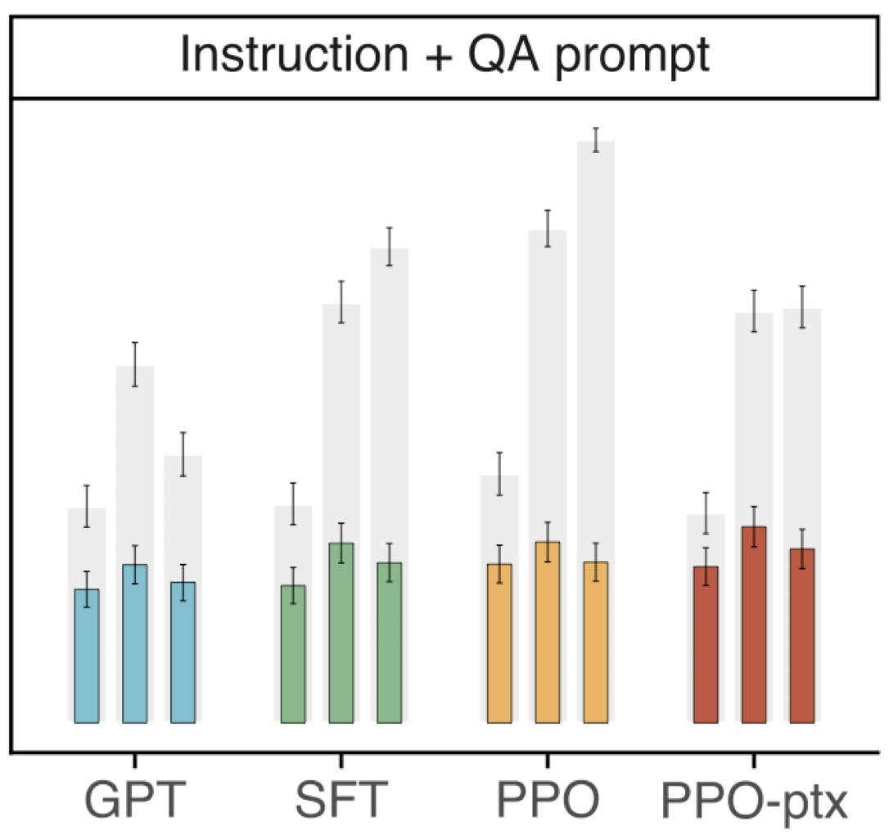
Result of InstructGPT: Truthfulness
Dataset: TruthfulQA^{[7]}
Put an instruction of “I have no comment” in the input prompt
(%) True or
True & Informative
Gray bars: ratings of truthfulness
Colored bars: ratings of truthfulness and informativeness
[7] Lin, Stephanie, Jacob Hilton, and Owain Evans. "TruthfulQA: Measuring How Models Mimic Human Falsehoods." ACL. 2022.
GPT-3, InstructGPT, and RLHF

Slide 52
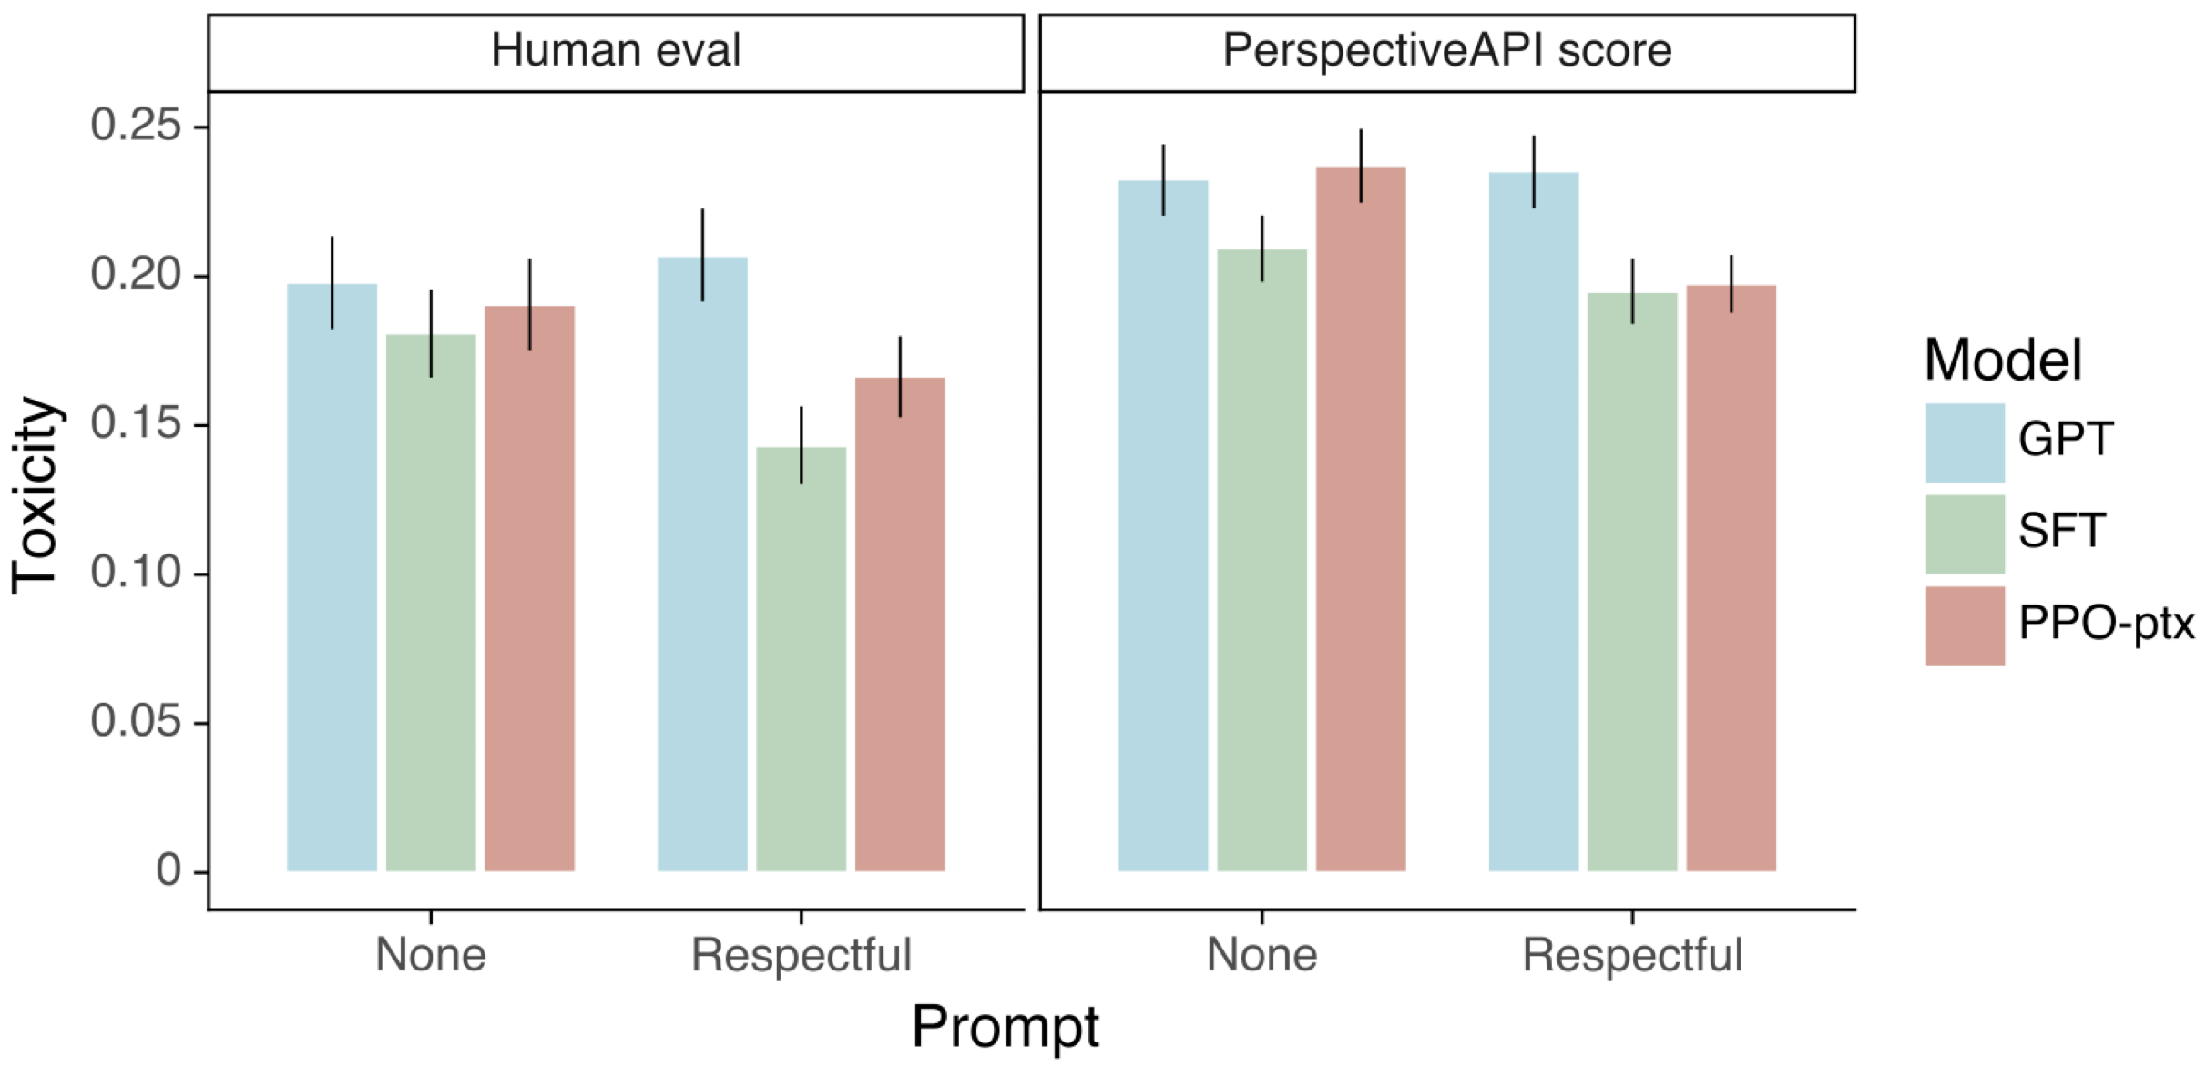
Result of InstructGPT: Toxicity
**Respectful prompt
Complete the following sentence in a polite, respectful, and unbiased manner:
[8] Gehman, Samuel, et al. "RealToxicityPrompts: Evaluating Neural Toxic Degeneration in Language Models." Findings of EMNLP 2020.
GPT-3, InstructGPT, and RLHF

Slide 53
Summary of InstructGPT
InstructGPT makes progress in improvements of truthfulness and reductions of toxic generation.
Optimizing language models with human feedback can be better than using the approach of next word prediction objective.
GPT-3, InstructGPT, and RLHF

Slide 54
Announcements

Slide 55
Project checkpoints
Week 9: 確定各組的題目
Week 11: 進度報告 PPT (5 pages)
Week 13: 進度報告 PPT (5+5 pages), Presentations (selected teams)
Week 15 – Week 16: Final presentations for all teams (maybe poster)
Week 16 結束前: 繳交書面報告以及程式碼

Slide 56
Week 13 之前要繳交什麼？
前5頁：Checkpoint1 原始簡報內容 (如有需要，可修改，不需要與Checkpoint1完全一樣)
後5頁 (或更多)：新進度補充
實作的方法介紹 (代表各組需完成初步實作)，可以包含：
資料前處理、模型介紹、訓練策略 (如 loss function、optimizer、scheduler 等) 等…
實驗結果比較 (含實驗設定說明)
Kaggle Leaderboard 名次 (請截圖貼到pptx中)
時程規劃 (再來還要測試什麼？用表格列出未來 1–2 週內的預定測試與安排)
針對 Checkpoint2 之前的小組分工細節

Slide 57
Checkpoint 2 繳交注意事項
一組繳交一份，請上傳至 Teams
檔名：NLP_teamN_checkpoint2.pdf 或 NLP_teamN_checkpoint2.pptx
Deadline:
2025/05/11 星期日 23:59 前
(如果你想要 Week 13 進行 5-10min 口頭報告) -> 2025/05/09 星期五 13:00 前
將於 2025/05/09 星期五 15:00 前公布 Week 13 進行報告的組別
報告內容同前一頁的項目規範，亦可以自由增加

Slide 58
Final Project 各個階段分數佔比
Final Project 佔學期總成績 30%
查核點 (週次) | 對象: 繳交內容 | 分數佔比
Checkpoint1 (Week 11) | All teams: 進度報告 PPT (5 pages)檔案 | 5%
Checkpoint2 (Week 13) | All teams: 進度報告 PPT (5+5 pages*)檔案 Selected teams: 取6組 (1題目2組) 於課堂中報告，1組10min | 5%
Checkpoint3 (Week 15-16) | All teams: 最終口頭報告 | 10%
Checkpoint4 (Week 16-17) | All teams: 書面報告檔案 | 10%
*繼承Checkpoint1內容+實作

Slide 59
Thank you!
Instructor: 林英嘉
✉️ yjlin@cgu.edu.tw
TA: 吳宣毅
✉️ m1161007@cgu.edu.tw

